Slide 1
Bankerz
Final Project

Slide 2
Dark Coders
Name of our Team : Dark Coders
Team Members
Nandini
Mohommad Siddiq
Aakashdeep Wahi

Slide 3
Design Challenges
Signing In Process
Dashboard (Home Page)
Transaction Page
Investment Page
Transfer Page
Chat UI

Slide 4
Questions
After research on several bank application, what user problems do you find out?
We have taken various banks application initially and observed them closely. The Main user problems that the banks have in their applications is the congestion of features at one point.
How are you going to solve these problems?
Limiting the features on the main pages. Keeping the basic features in staring pages and them make different pages for different things.
What will be your innovative solution?
Making a simple and Easy UI For the banking Application named as Bankerz.

Slide 5
Bankerz
Bankerz is a banking application developed by the Dark Coders it has been made by keeping in mind the simplest approach that we can follow to do a work. We have tried to use minimum number of clicks as possible.
We have made 6 different pages.
We have followed minimalistic design features.

Slide 6
Design Process
Firstly, we have discussed the various ways we can approach.
We have made several on paper design then we have chosen one of them and made it a High Fidelity design on Adobe XD.
Then we have approached the coding part.
After that we have done the usability testing.
At last, We have reviewed and finally submitted the code.

Slide 7
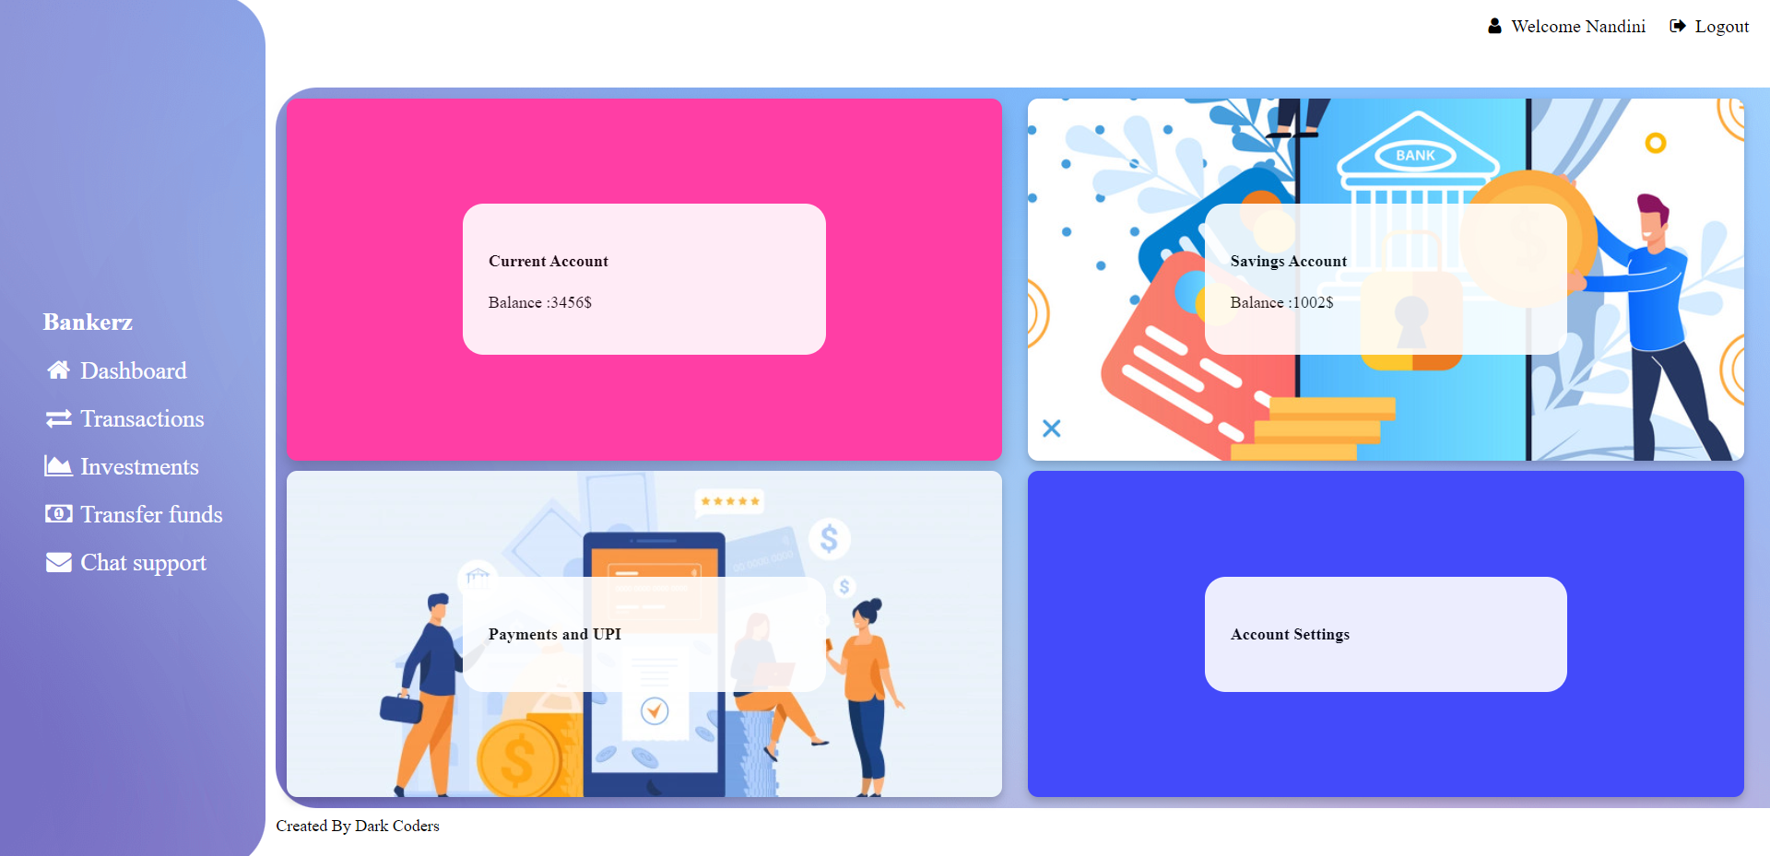
How do you solve the user's problems?
We have made simple UI with minimal clicks to use.
Our login page is just a single click away.

Slide 8
What roles do you play in the team?
Aakashdeep Wahi :- I have done the designing part of the website.
Mohammad Siddiq :- He have done all the Responsiveness and accessibility testing.
Nandini Handa :- She has done with all the coding part on the website.

Slide 9
How do you effectively contribute to teamwork?
We have divided the work properly and everyone has done their work nicely and with perfection.
We have shared the work properly and whenever we need any kind of assistance like one person got stuck somewhere then we have done zoom meeting and solved the problems.
In this way we have effectively contribute to teamwork.

Slide 10
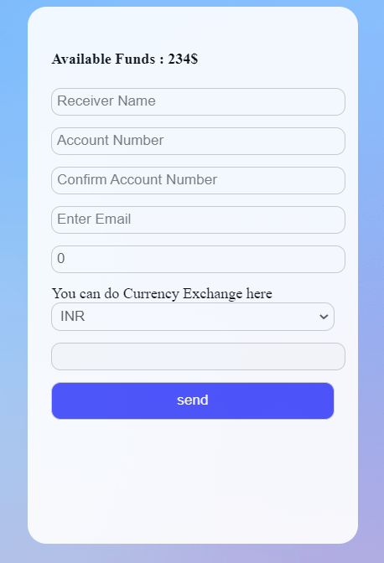
Conduct a usability test after you finish your application. Based on usability test, what changes did you make?
We have done usability testing with one of my friend and said her to send money to one of the account number.
She then logged in the site after that she have clicked on the transfer funds and then filled up all the details.
At last she has pressed the send button.

Slide 11
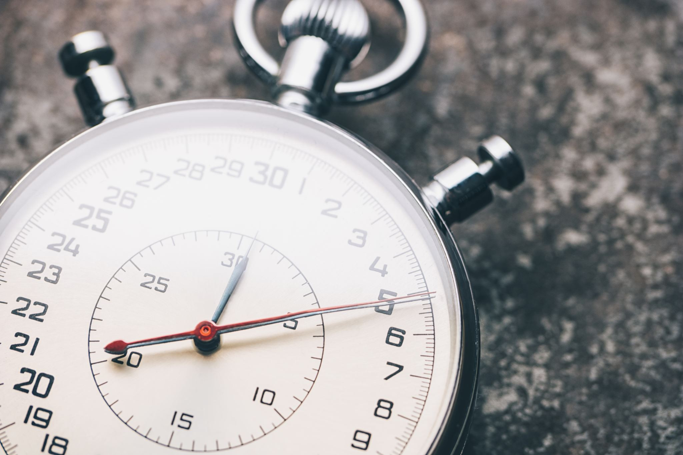
The End
Thank You
For your Time

